Slide 1
Welcome to ifgl
www.ifgl.info

Slide 3
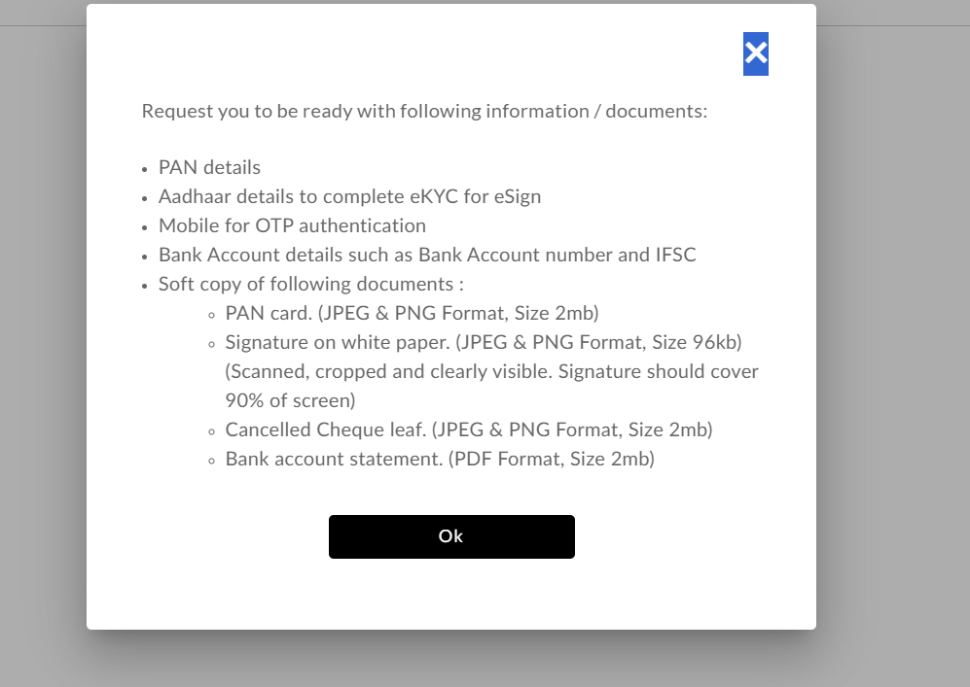
For online account opening you need following document :-

Slide 4
Open website www.ifgl.info

Slide 5
New registration page

Slide 6
Click on ok

Slide 8
After successful verification of OTP(If your KYC already done) client will move to PAN Verification page where we have integrated two services : 1) PAN verification with ITD 2) KYC status for Mentioned PAN

Slide 9
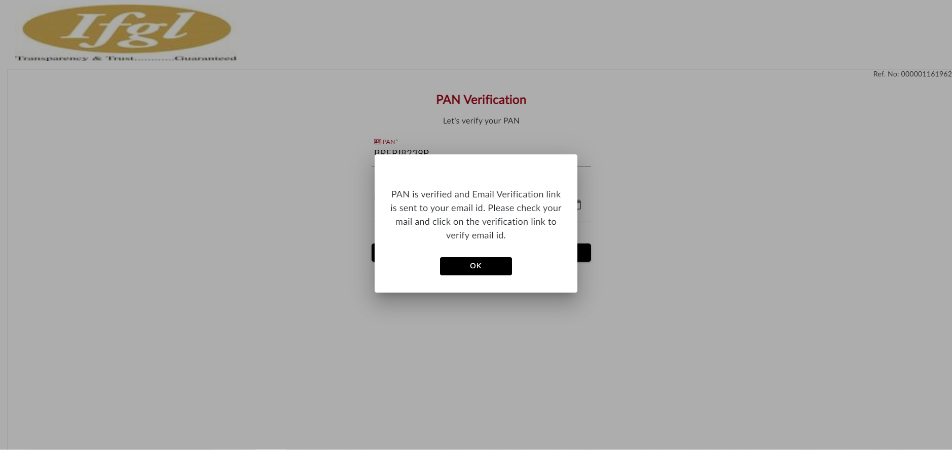

Slide 10
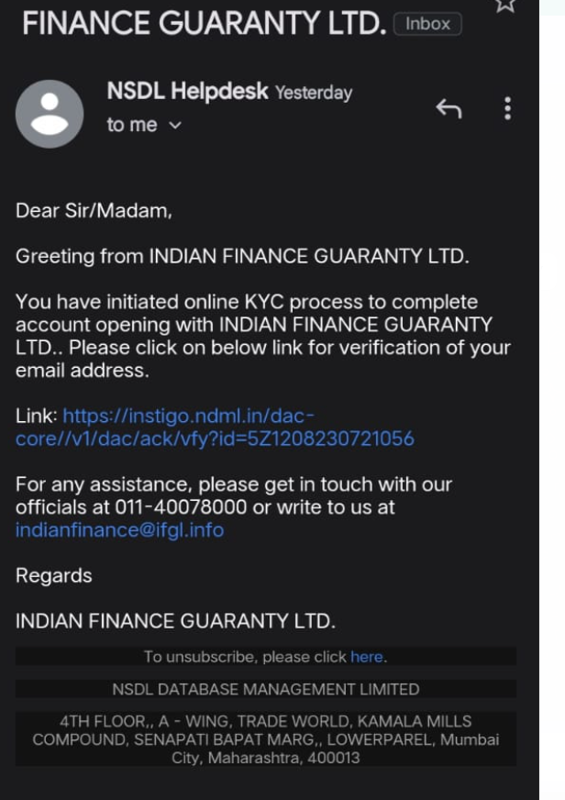
Check your email & verify your email id

Slide 11
Note: If your KYC not done than you will get this page on your screen

Slide 12
These are following step

Slide 14
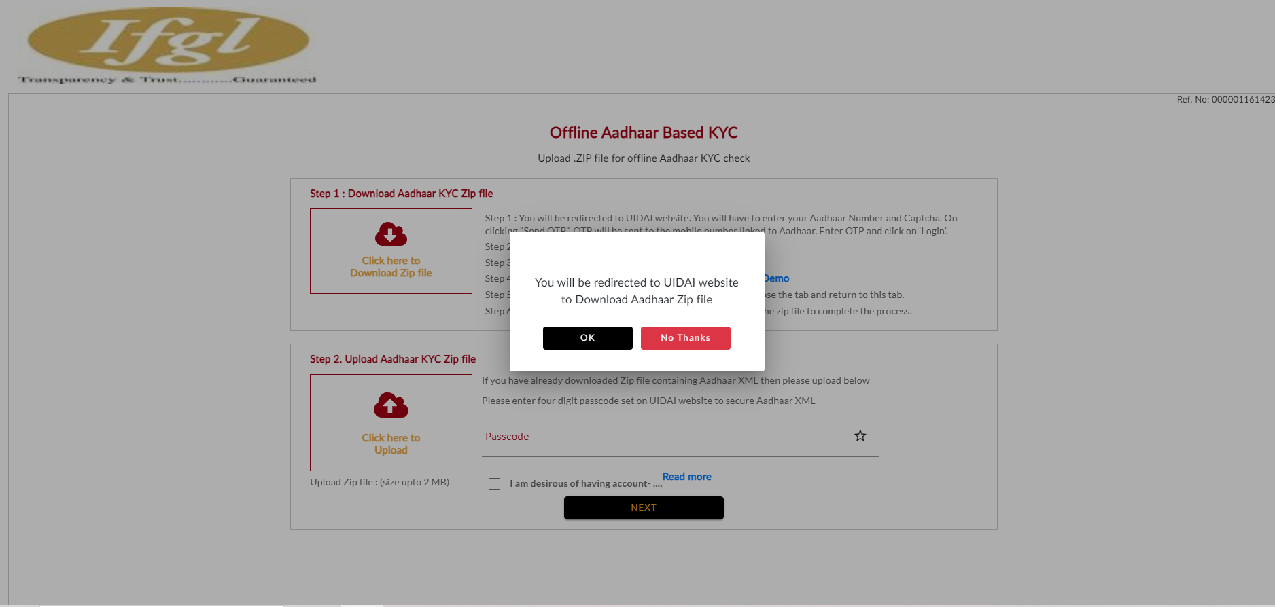

Slide 15
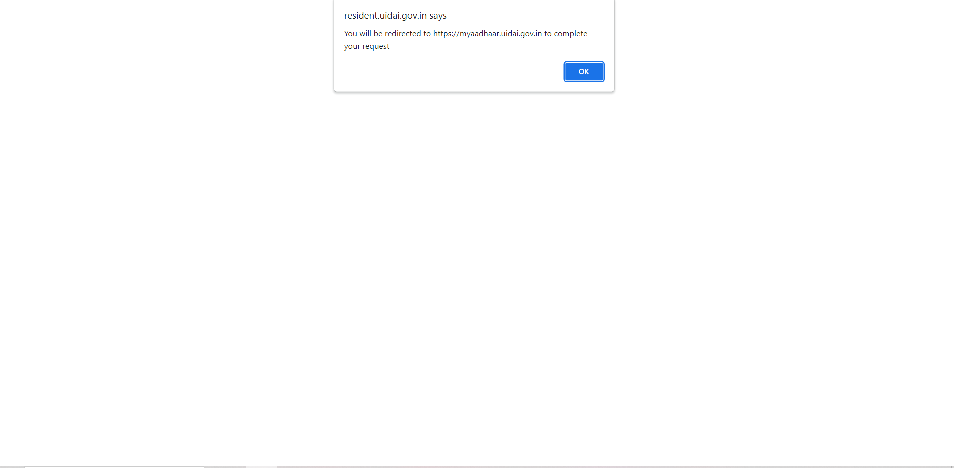

Slide 16
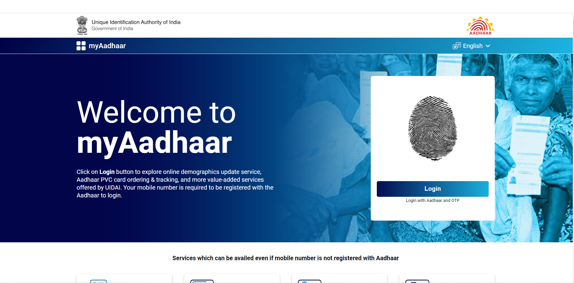

Slide 17
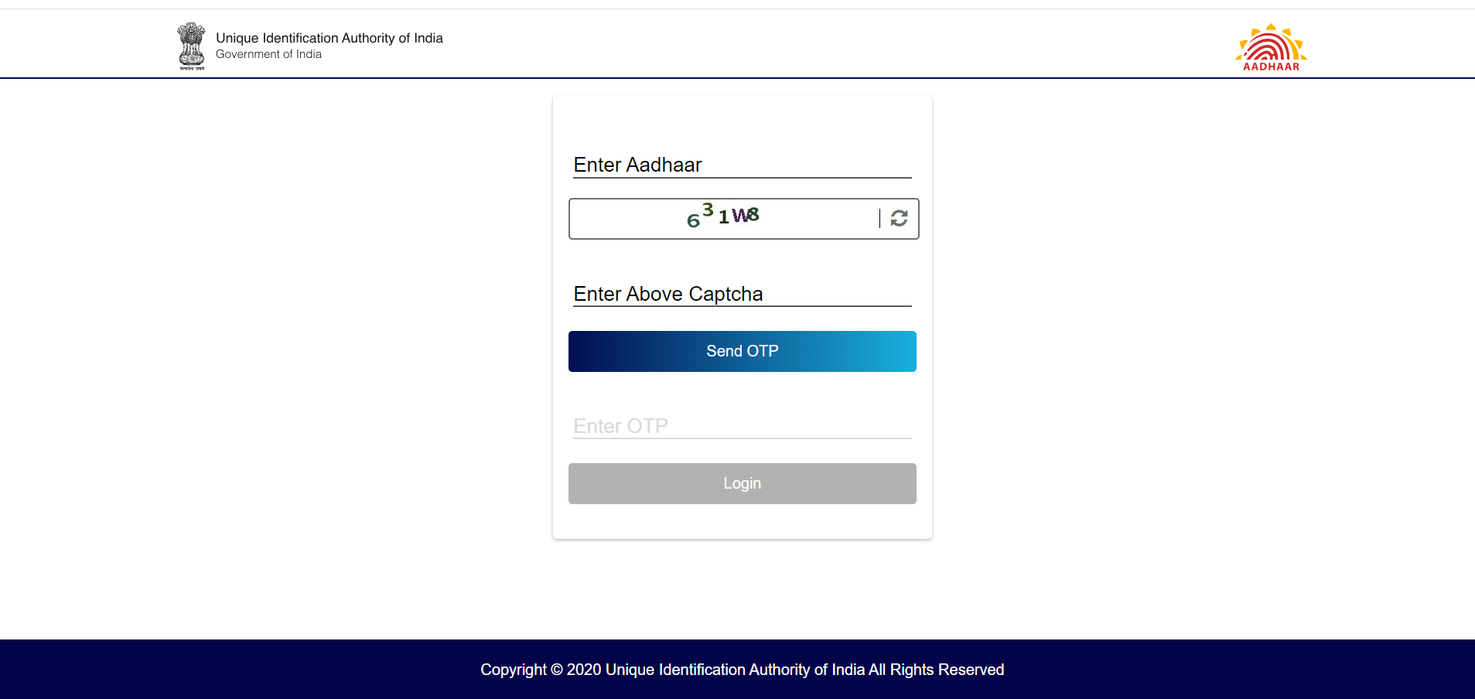

Slide 18
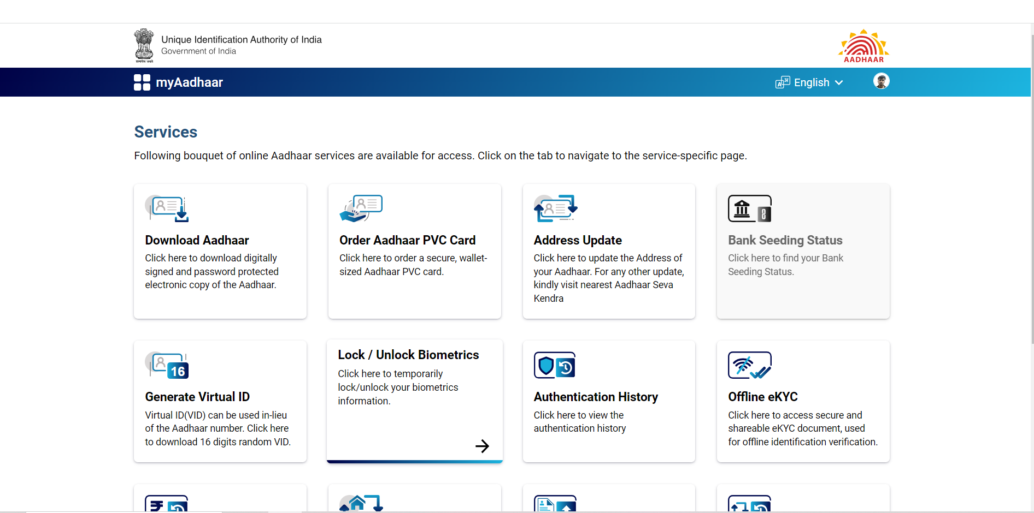

Slide 19
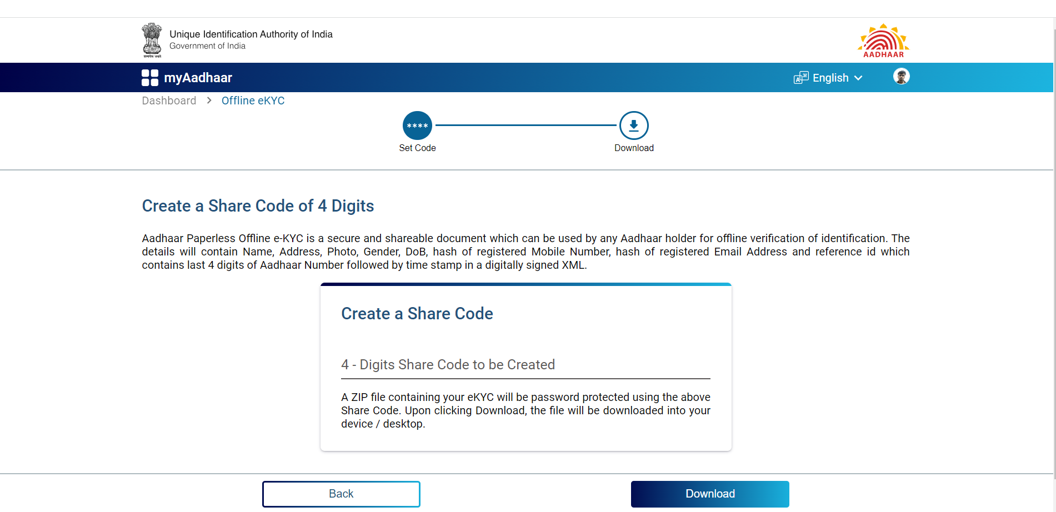

Slide 20
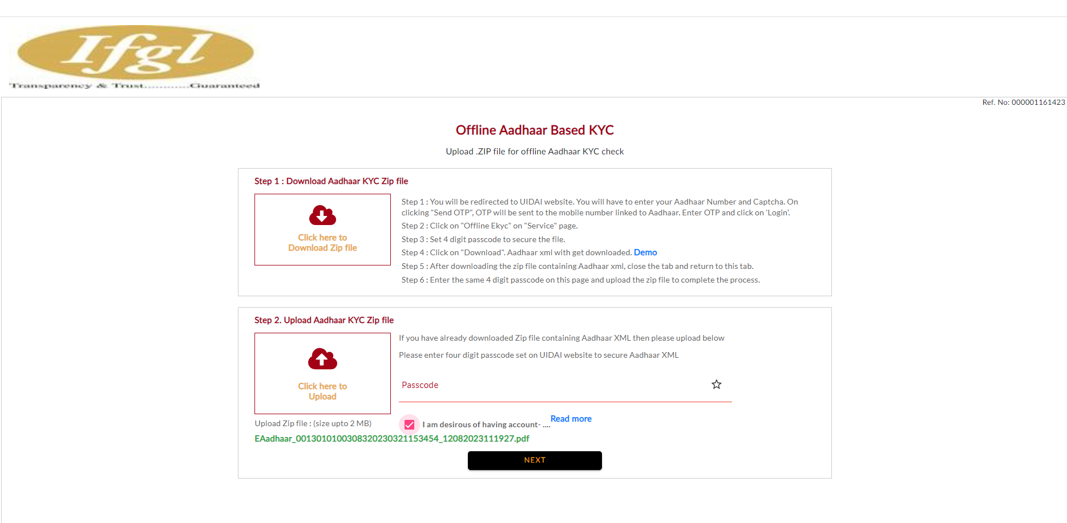

Slide 21
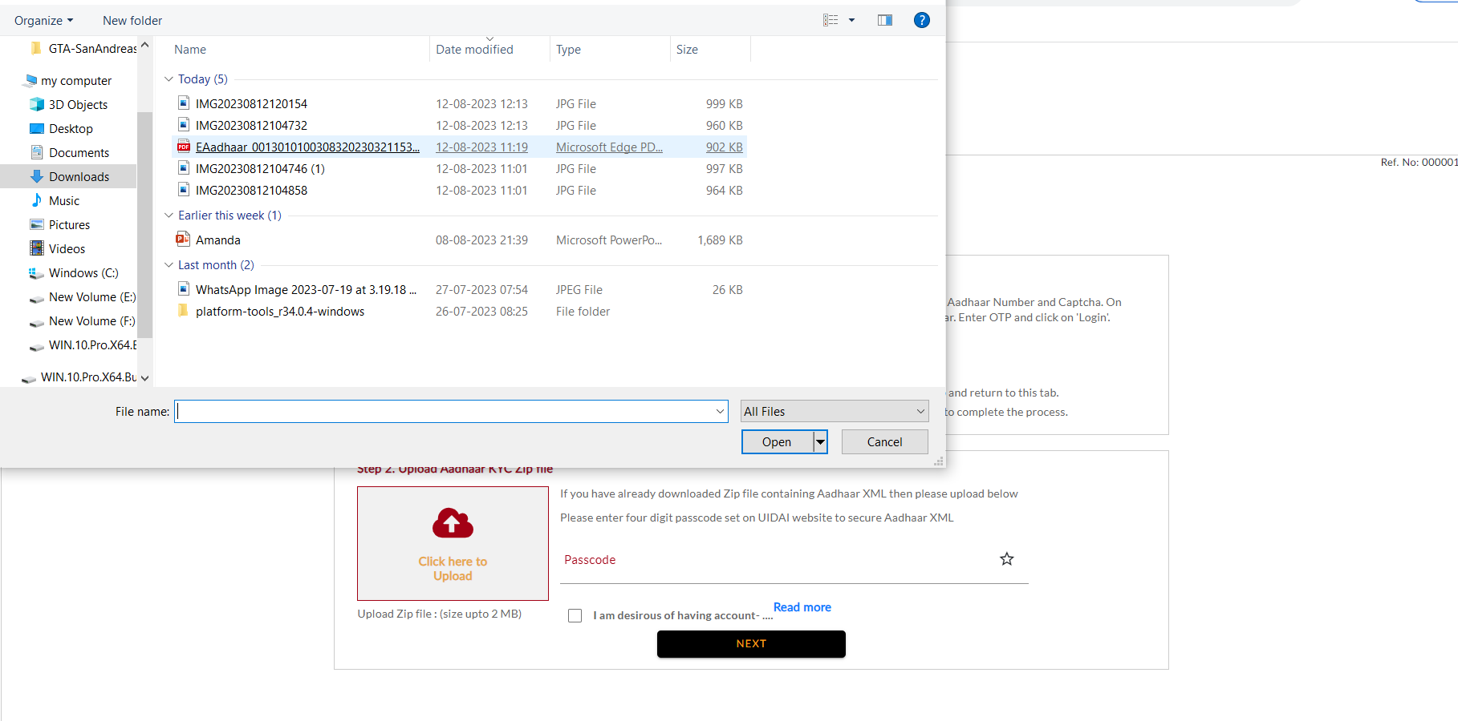

Slide 22
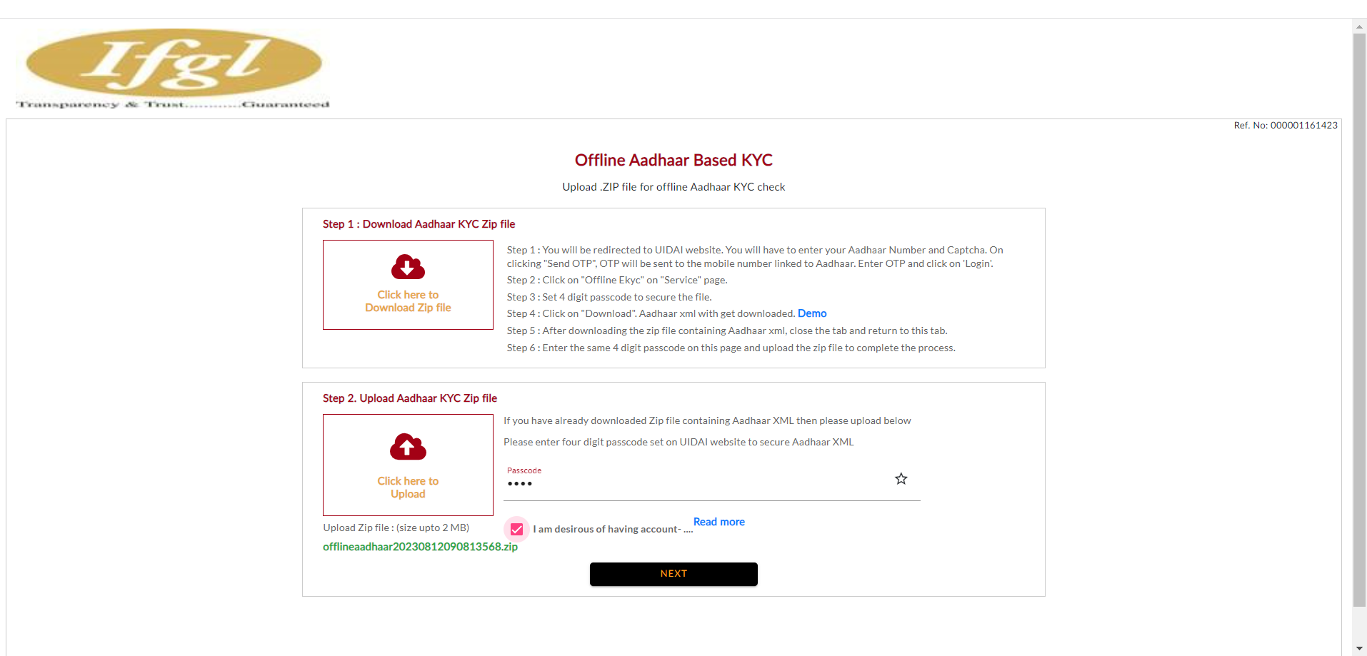

Slide 23
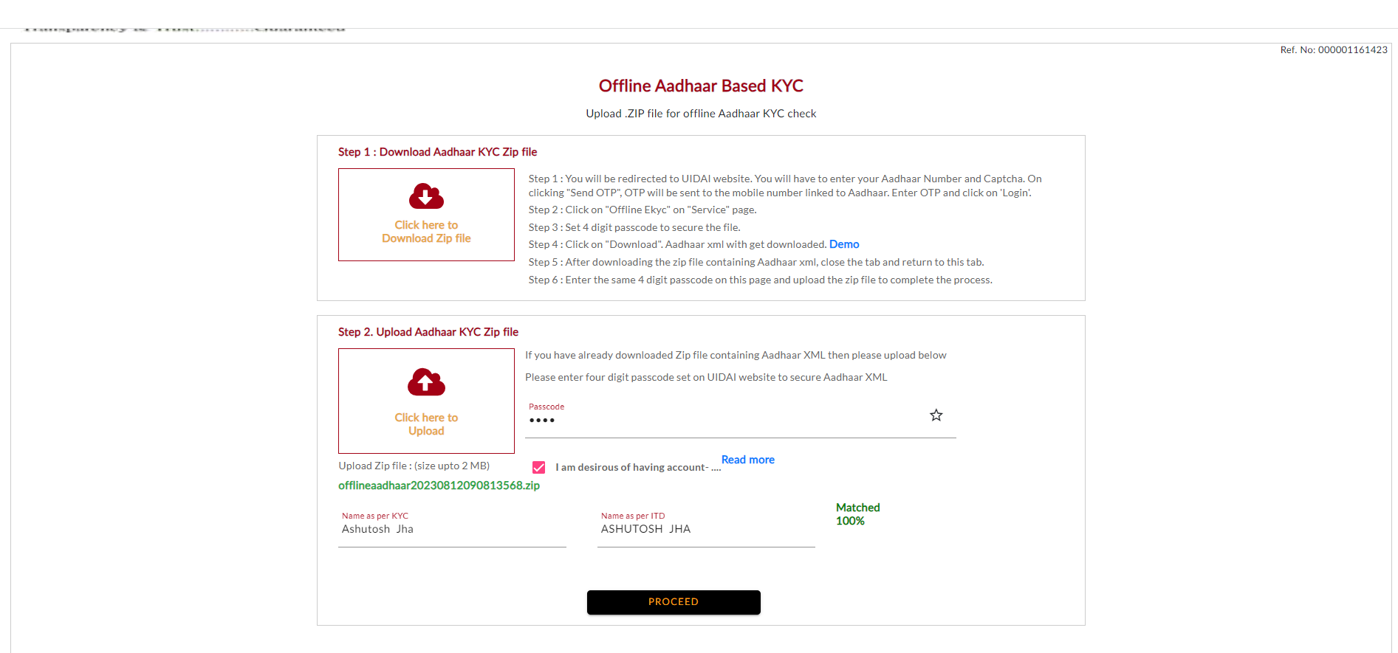

Slide 29
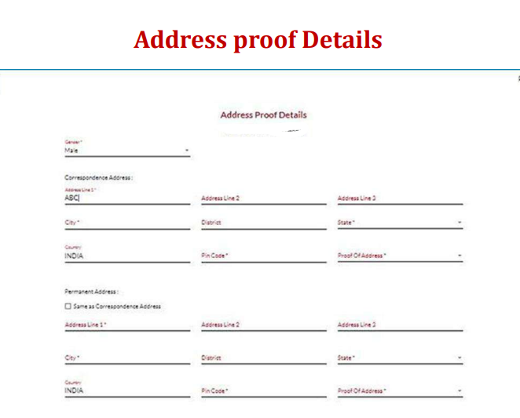

Slide 30
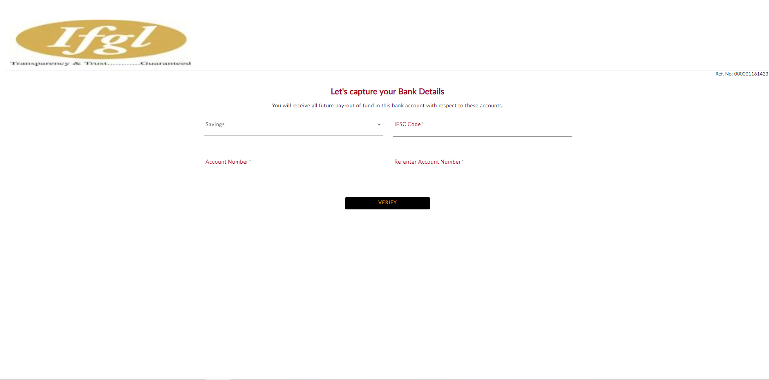
Let’s Capture Your Bank Details

Slide 31
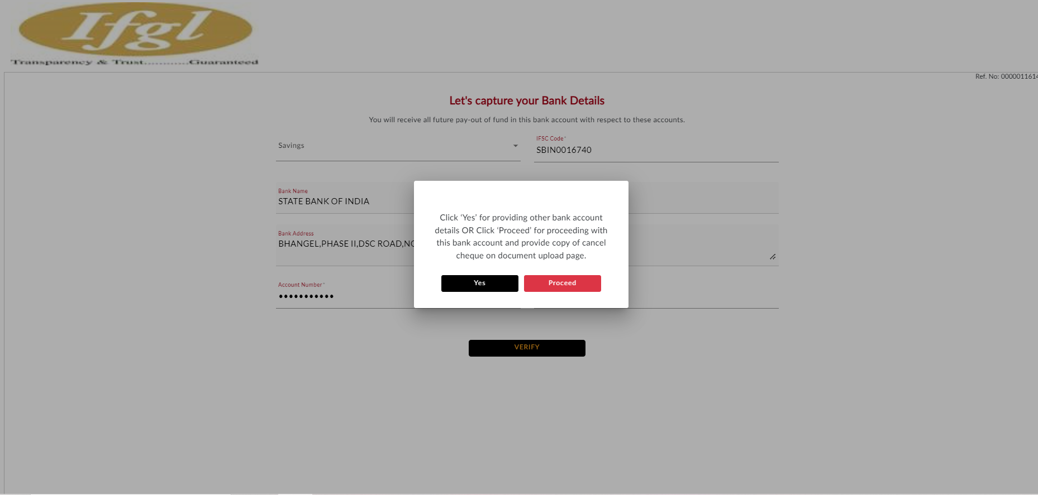

Slide 32
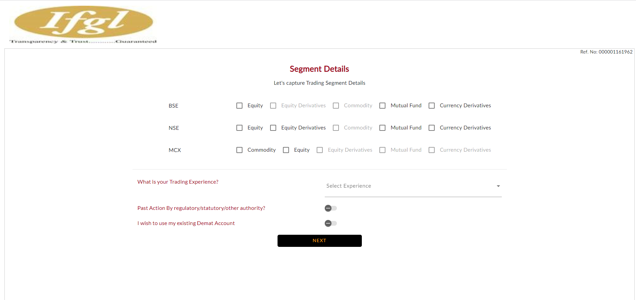

Slide 33
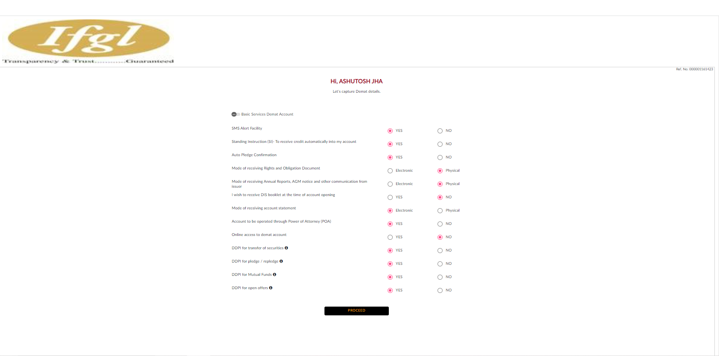

Slide 34
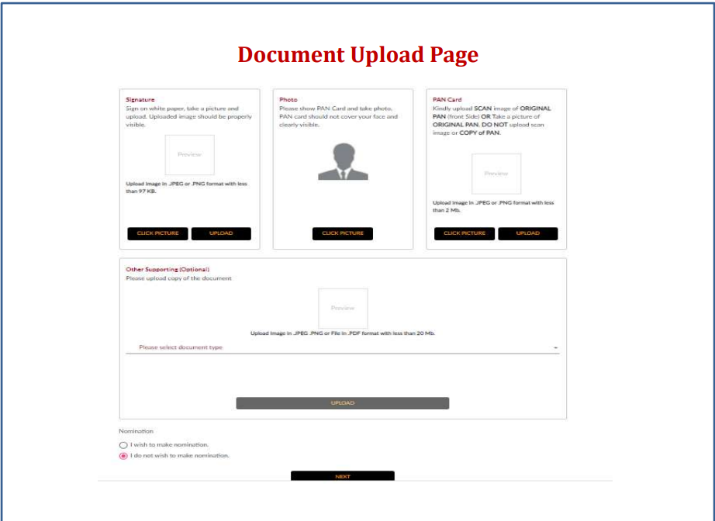

Slide 35
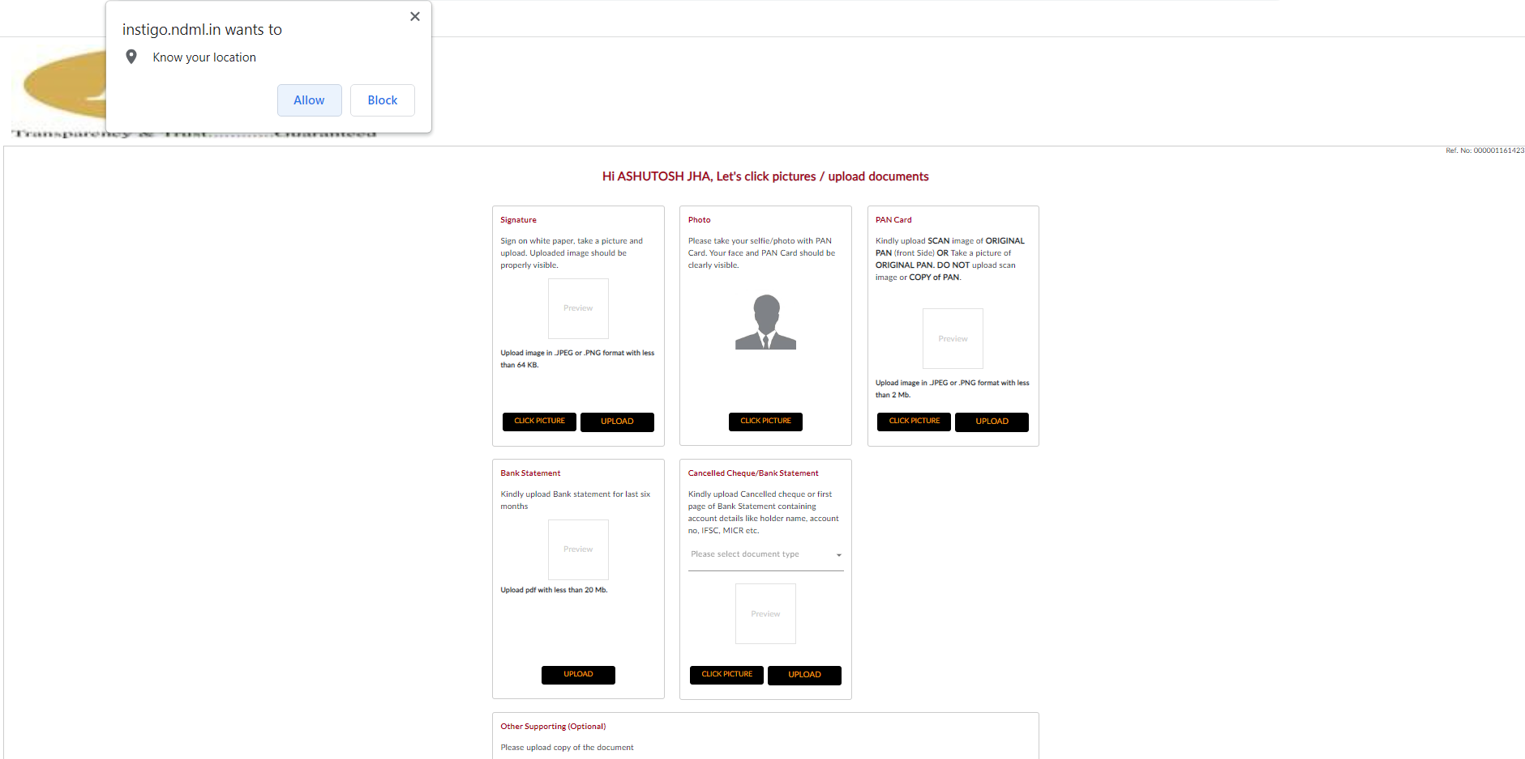
Allow the location and upload other document

Slide 36
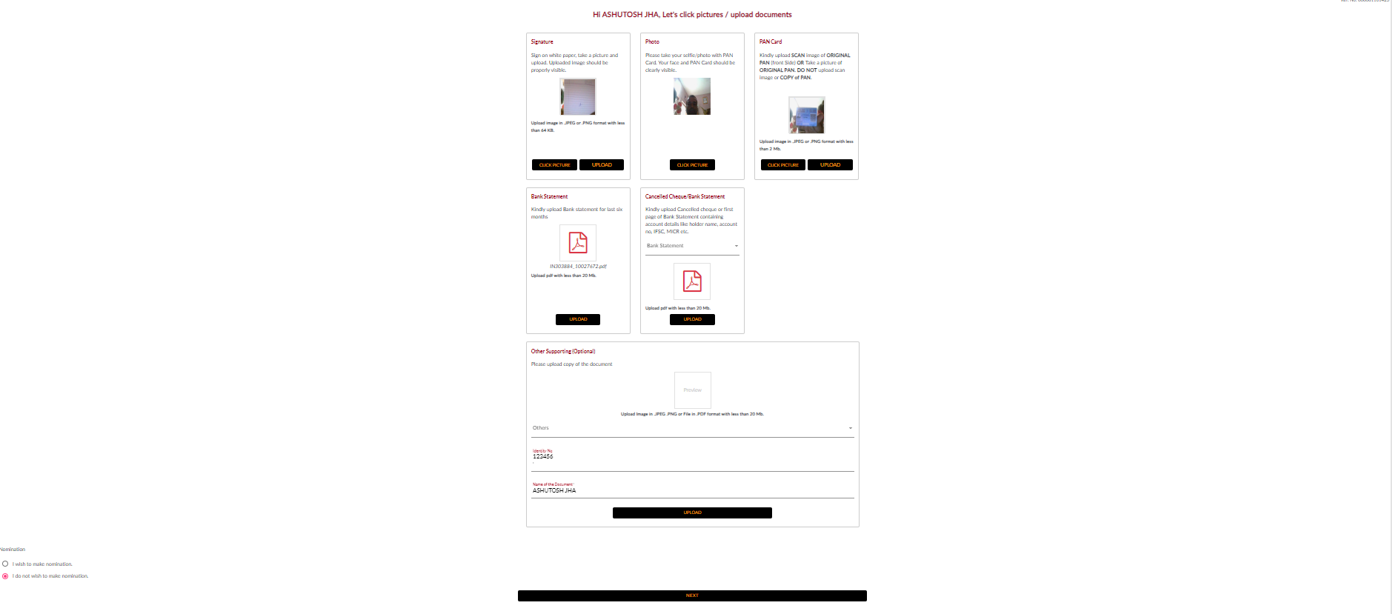

Slide 37
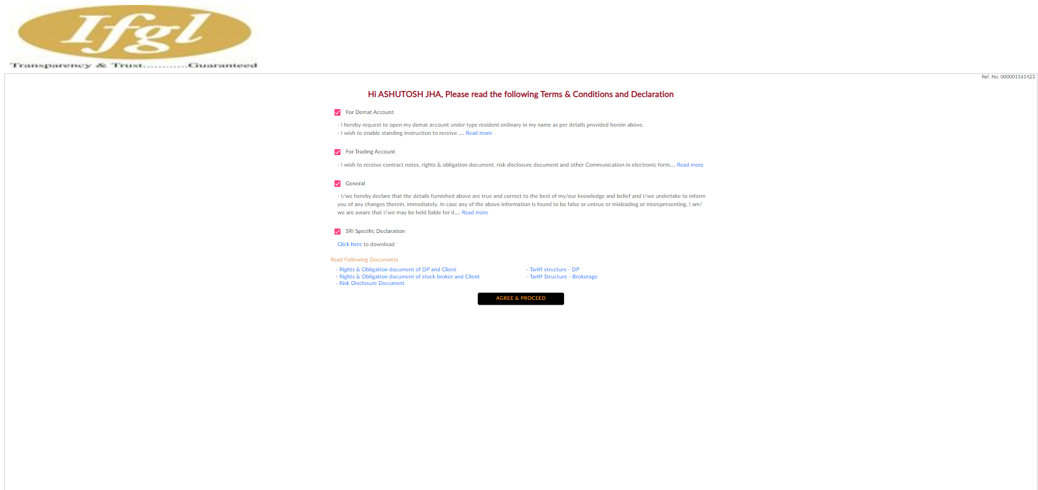
Read the following term & and declaration

Slide 38
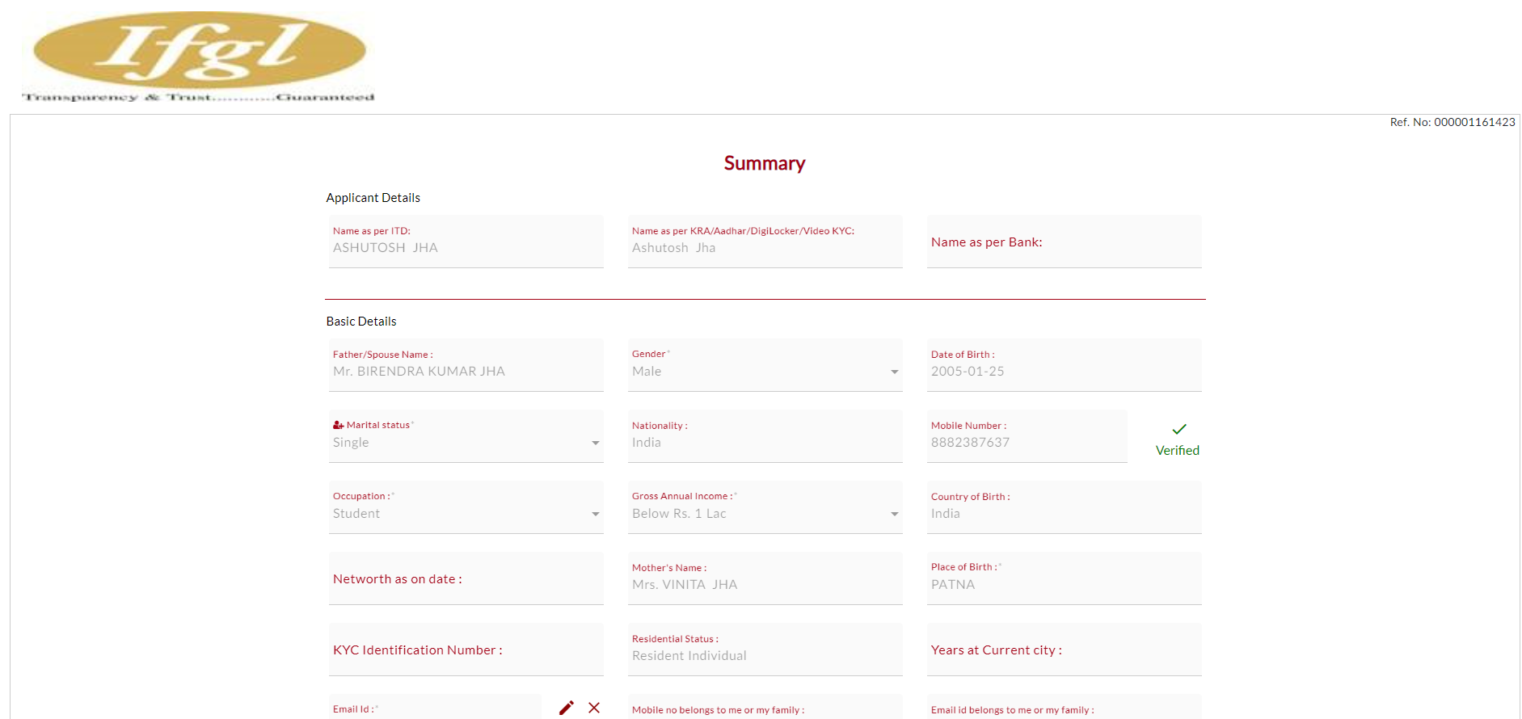

Slide 39
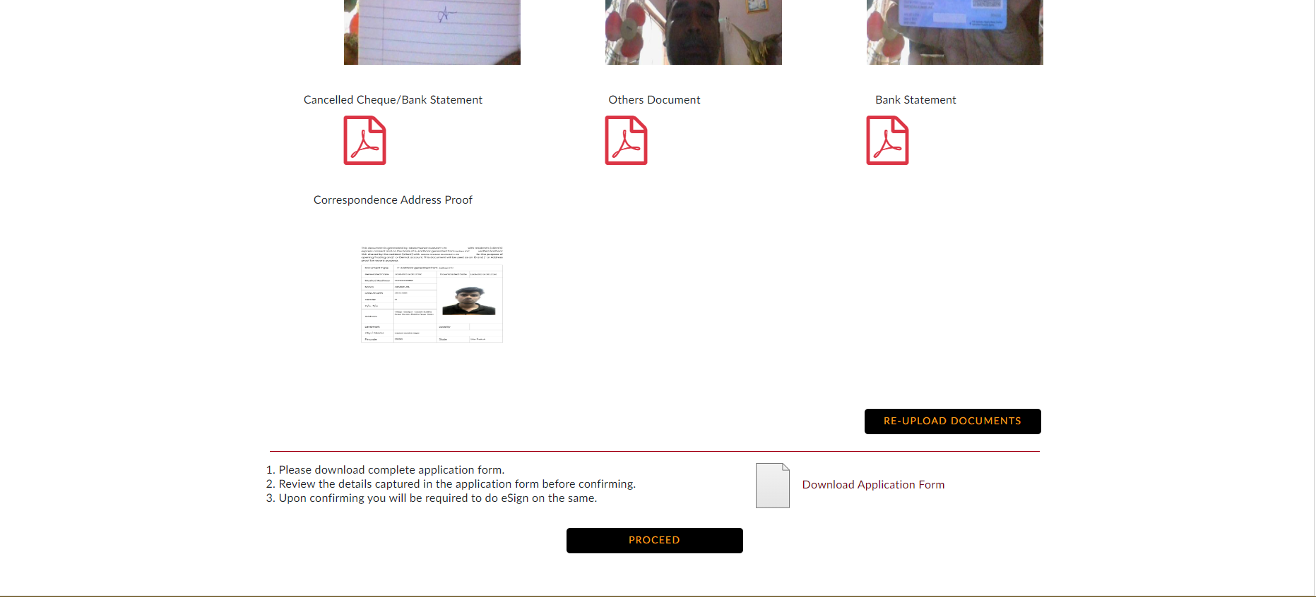

Slide 40
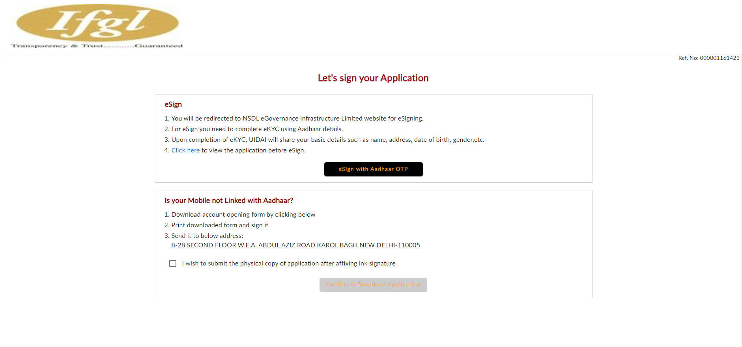
Let’s sign your Application

Slide 41
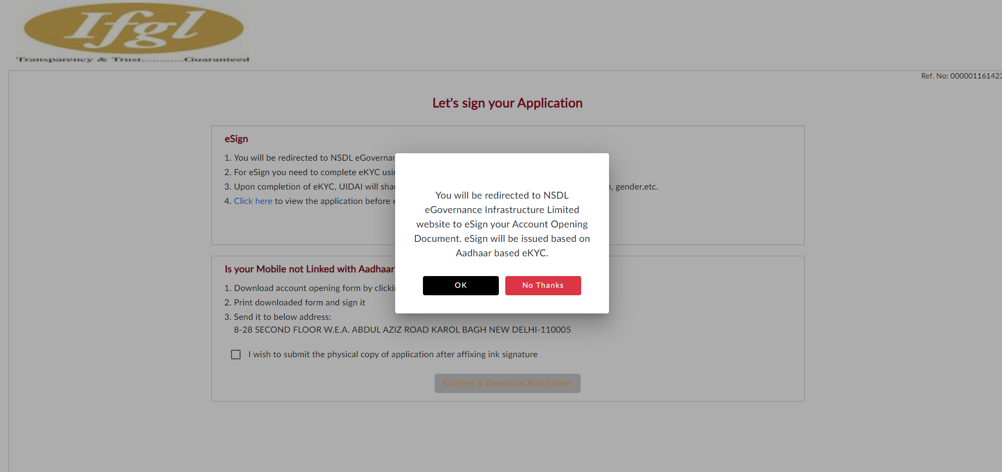

Slide 42
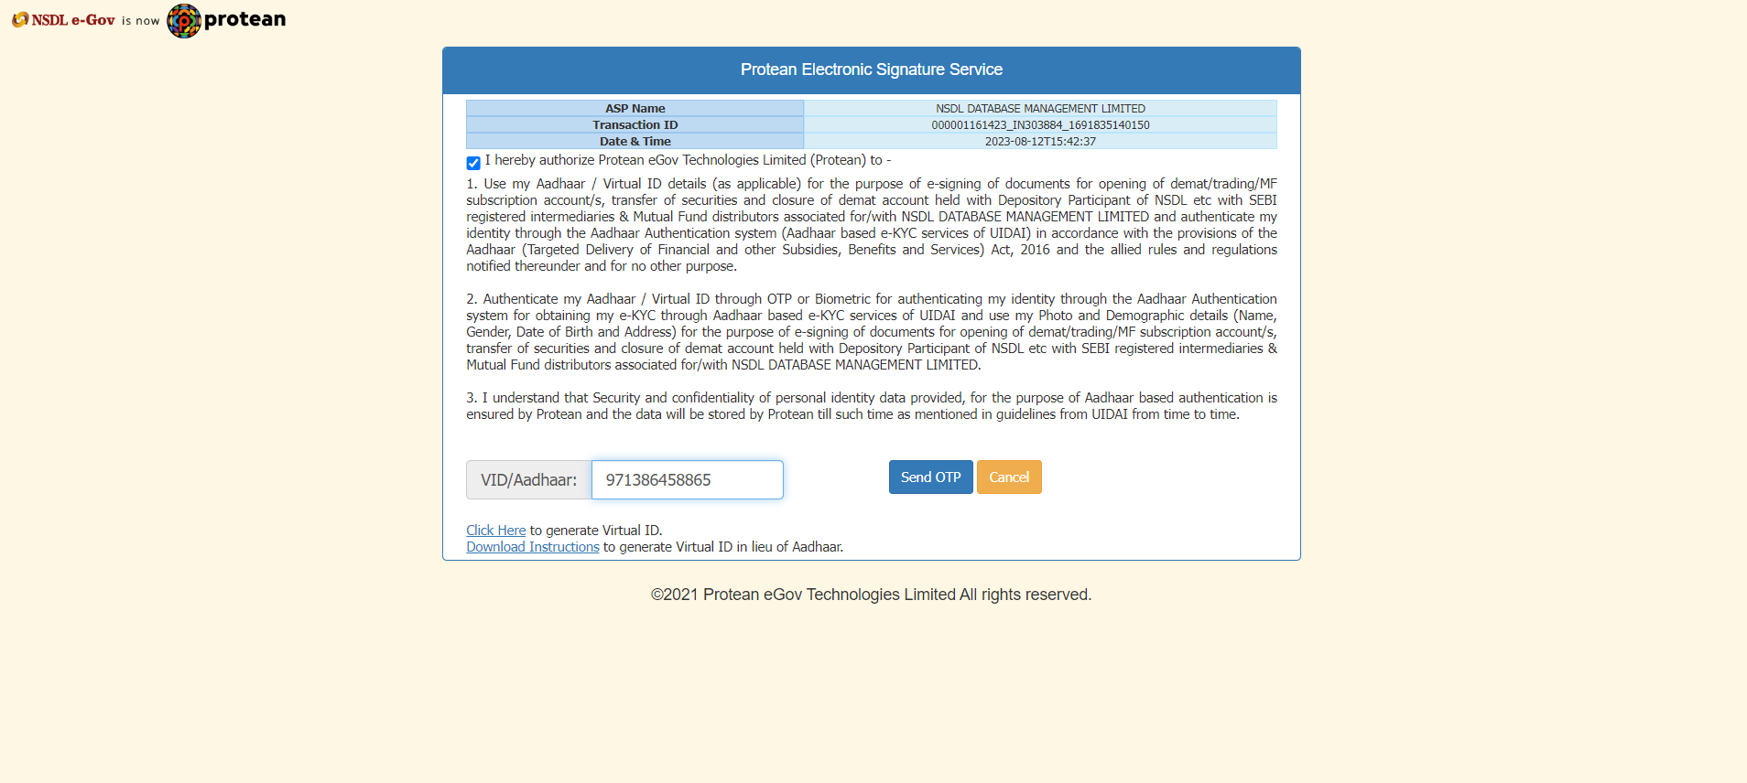

Slide 43
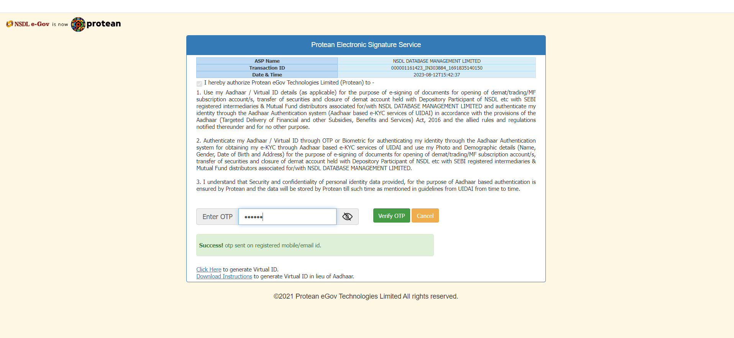

Slide 44
